Slide 1

Intro to NServiceBus
3 – Building a One-Way Messaging App

Slide 2
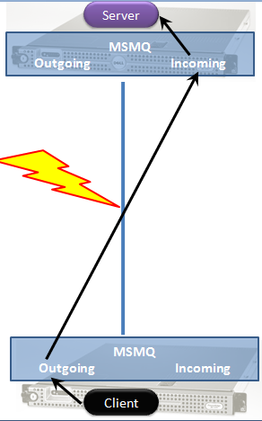
This is store and forward
Client puts a message in a queue on the server
Then goes on its way

Slide 3
Steps
Create a project, add NServiceBus references
Create a message
Create a service endpoint
Create a message handler
Add persistence
Create a host
Send a message

Slide 4
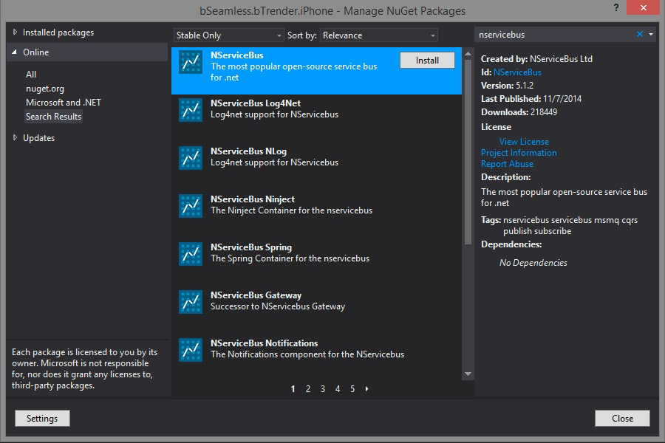
NuGet install (for the app only)

Slide 5
Packages
NServiceBus.Interfaces
NServiceBus
NServiceBus.Host
NServiceBus.Testing

Slide 6
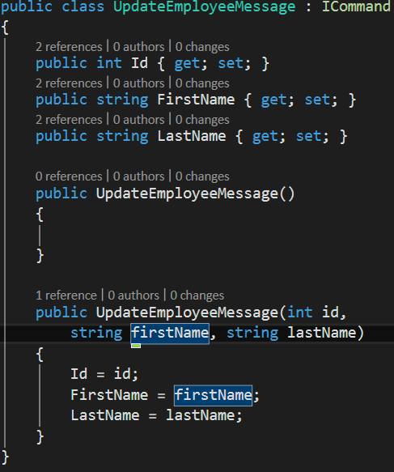
Message
Any object based on IMessage
“Commands” are based on ICommand
NServiceBus applies command semantics to those messages (in the mindset of CQRS)

Slide 7
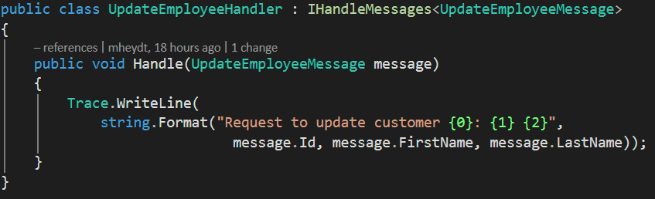
Receiver
Implements IHandleMessage

Slide 8
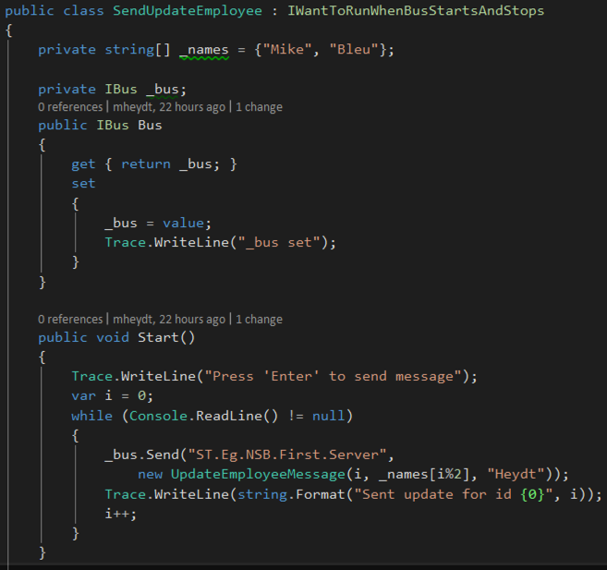
Sender
Calls Bus.Send() passing it a message and the name of the queue to deliver it to
Client goes on its business

Slide 9
The endpoint in the send
Is the name of the endpoint
Which represents a configuration entry which has many parameters such as:
Which machine and queue on that machine
What messages can be sent or read from the endpoint
Various durability parameters
Security / authorization options

Slide 10
Configuring the EndPoint
Three ways to do it
Convention
Fluent
Configuration objects
Sets various options
What is the name of the endpoint
How is state of the endpoint managed
Should the endpoints be created in MSMQ?
What messages are handled on the endpoint?
And what queue on which system should the endpoint be located on (the address)
These need to be figured on both client and server
There are default options which make it very simple

Slide 11
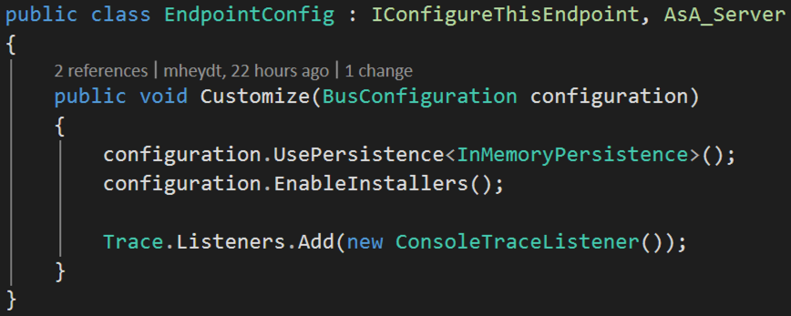
Convention based
AsA_Client, AsA_Server
IConfigureThisEndpoint

Slide 12
Configure a the endpoint
We will use in memory persistence. This is for state, not the actual messages; those will use MSMQ
And, enable installation
This last one is important. Otherwise, if the queues do not exist they will not be created and the programs will fault.

Slide 13
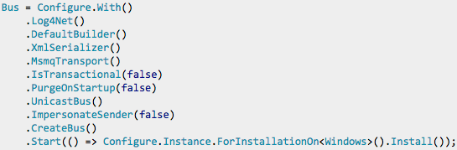
We can also create the bus fluently

Slide 14
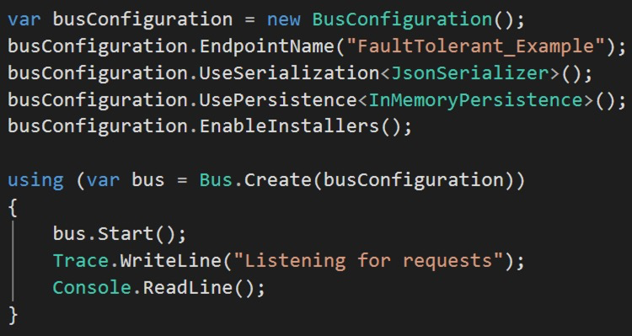
Or using configuration objects

Slide 15
Start…
Both the server
And the client

Slide 16
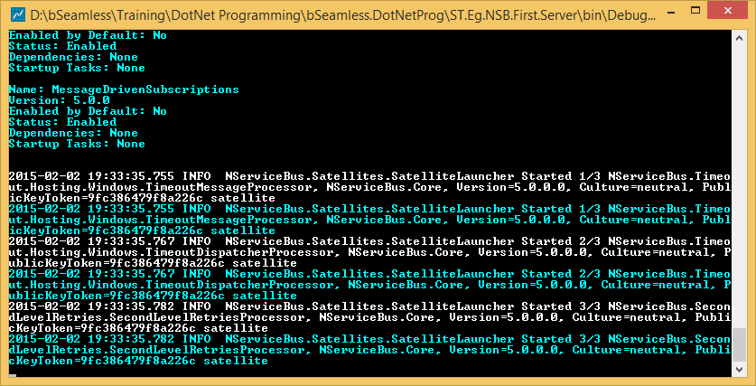
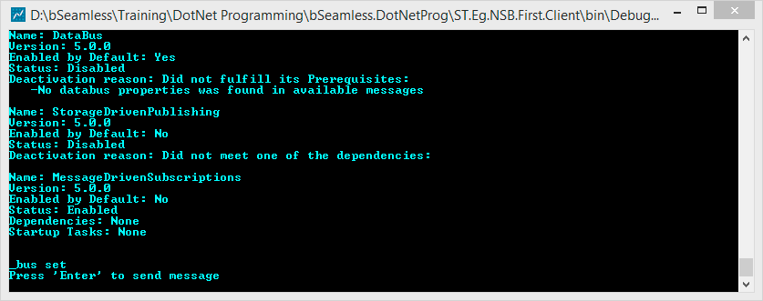
A lot of diagnostics will roll by

Slide 17
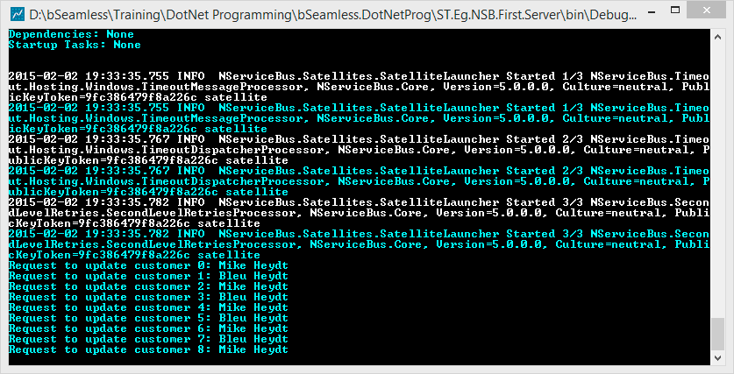
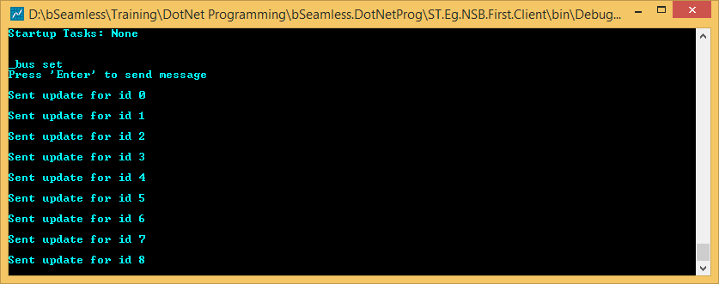
But start pressing enter and messages flow

Slide 18
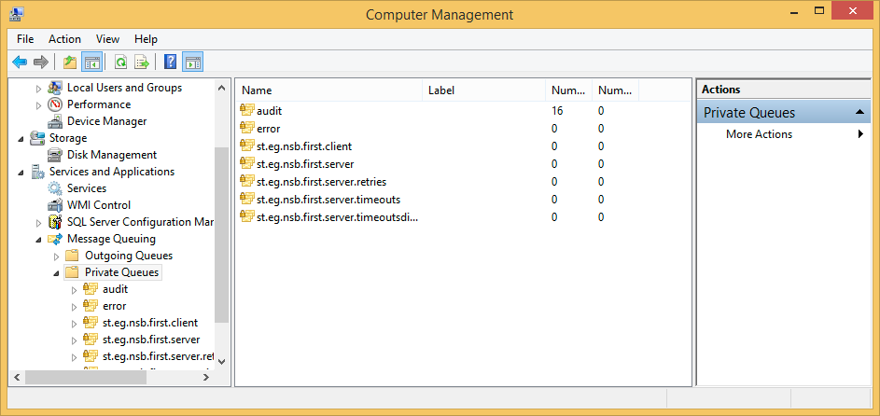
Over in MSMQ Manager
We have a lot of queues created
1 for the client
And 4 for the server
Default names/address are the namespace

Slide 19
Note also:
IBus was injected into the client. NServiceBus uses IoC and can also be configured to us Ninject.
Also, heavy use of long interface names for various roles (which I like)
IWantToRunWhenBusStartsAndStops
IHandleMessages

Slide 20
Summary
Basic One-way messaging example
Configure server to listen for a message on an endpoint
And a client which sends a message to that servers queue
The message is derived from IMessage or ICommand

Slide 21
Demo

